Slide 1
are outsiders simply those who are misjudged or misunderstood?

Slide 2
Introduction
Summarize your introduction. Present a clear answer to the question: are outsiders simply those who are misjudged or misunderstood?

Slide 3
“The Metamorphosis”
Summarize how “The Metamorphosis” supports your answer. Include the quote or quotes you used in your paper.

Slide 4
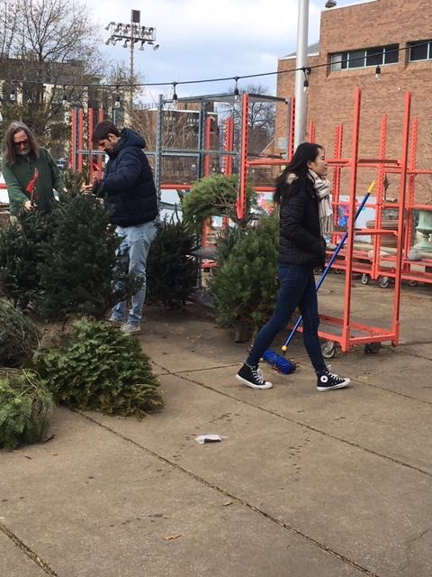
Real life examples
Summarize the example or examples from your life that supports your answer.

Slide 5
Counterclaim
Present a counterclaim that could be made about your opinion. Explain why this idea is wrong and why your idea is correct.

Slide 6
Conclusion
Summarize your conclusion.

Slide 7
The end
Any questions?

